Slide 1
Practical management of infant sleep problems
Associate Professor Harriet Hiscock
Paediatrician and postdoctoral research fellow
Centre for Community Child Health
The Royal Children’s Hospital,
Murdoch Childrens Research Institute

Slide 2
Sleep
A good laugh and a long sleep are the best cures in the doctor's book. Irish Proverb
The worst thing in the world is to try to sleep and not to. F. Scott Fitzgerald
People who say they sleep like a baby usually don't have one. Leo J. Burke

Slide 3
Outline
Normal sleep and its regulation
Normal crying
Case study – 3 month old baby
Case study – 8 month old baby
Medication
Sleep resources

Slide 4
Architecture of sleep
2 distinct systems
Light or Rapid Eye Movement (REM) sleep
Deep or Non-Rapid Eye Movement (NREM) sleep
Present from 3 months in utero

Slide 5
Ontogeny of REM and NREM Sleep
Total Sleep Time
25
REM
20
NREM
15
10
5
0
28 Wk
35
Wk
Term
1 Mo
5
Mo
12
Mo
2
Yr
5
Yr
10
Yr
16
Yr
Age
Sheldon SH, Spire J-P, Levy HB: Pediatric Sleep Medicine. Philadelphia. WB Saunders. 1992,

Slide 6
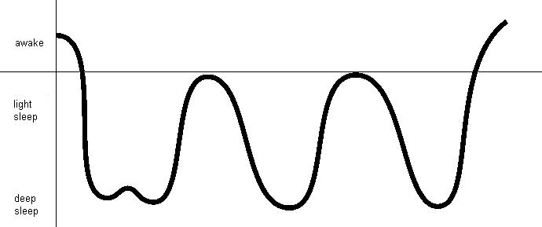
NREM

Slide 7
Sleep cycles
We all cycle through REM and non-REM sleep
Cycles last 50-60 mins in children; 90 mins in adults
Typically in non-REM sleep for first few hours of the night and then start waking from REM sleep after this

Slide 8
Sleep cues
The way we fall asleep at the start of the night is the way we expect to return to sleep when we wake overnight from REM sleep
So if the last thing a baby remembers is falling asleep on the breast, in parent’s arms etc....then that is the way they want to return to sleep if they wake overnight.

Slide 9
What regulates our sleep?
Two part system
  Homeostatic regulation
  Circadian regulation

Slide 10
Homeostatic regulation
“Drive to go to sleep”
If you have poor quality sleep or not enough of it → feel tired → drive to get to sleep
eg afternoon nap if woke up a lot overnight

Slide 11
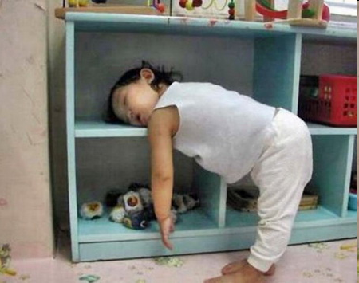

Slide 12
Circadian rhythm
Rhythm maintained by environmental cues
  Light / dark – melatonin released when it is dark
  Timing of meals
  Scheduled activities eg getting to daycare
  Body temperature – drops at night to help us go to sleep

Slide 13
Circadian rhythm
Troughs
  Late afternoon
  Middle of the night
  This is when we often feel the most sleepy!
Peaks
  Early morning
  Evening – this is when kids can get a ‘second wind’

Slide 14
“Usual” sleep patterns
First weeks home
  sleep  feed  sleep → feed etc
More night sleep from 3 weeks; consolidated by 12 weeks
  “sleeping through” ie block of sleep lasting 8 hours: median age 3 months¹
        ¹ Henderson et al Pediatrics 2010

Slide 15
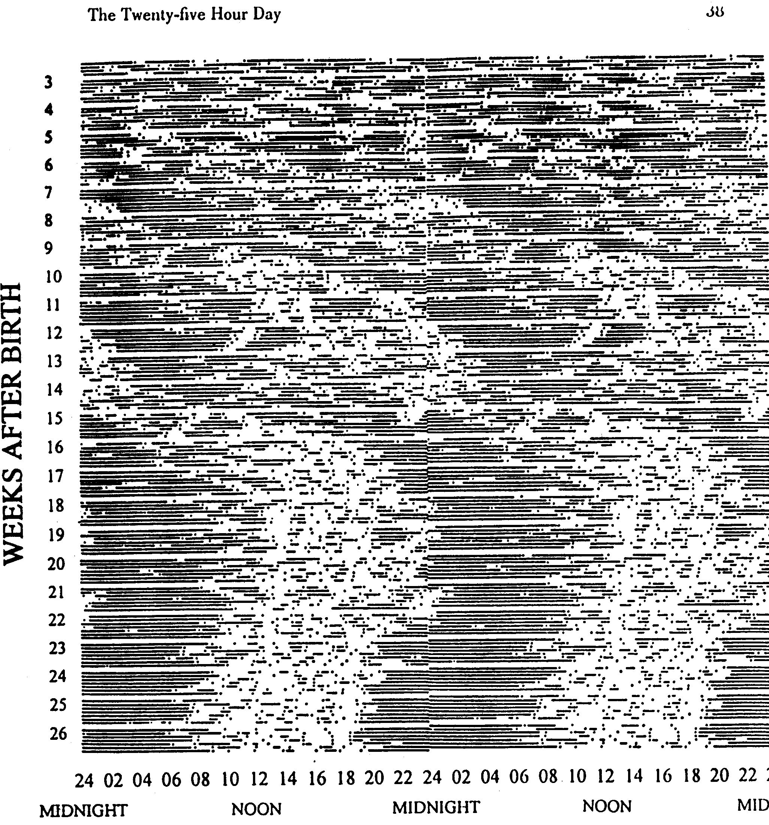
Settling into a pattern

Slide 16
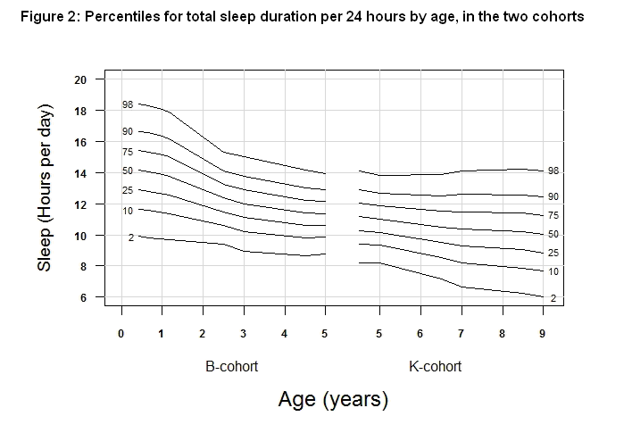
Notes:
The number and length of night wakes, number of sleep episodes and length of daytime and total sleep duration were greatest at age 4-6 months, showing a steep decline in the first 3 years before a flatter, continuing decline to 9 years. The variation in sleep parameters followed a similar pattern, except from an increase in total sleep duration from 6-9 years, and a brief increase in length of night wakes at 6.5 years.
The range in sleep duration (Figure 2) was large throughout, though the width and timing of the span differed somewhat by age. At age 4-6 months, more than 8 hours of sleep per day separated the 2nd and 98th centiles (spanning 10-18 hours), falling to a difference of just over 5 hours at age 5 (spanning 9-14 hours) before rising again to a difference of around 8 hours at age 9 (spanning 6-14 hours).
This reduction in total sleep duration was driven mainly by two factors: progressively later sleep onset times (Figure 3), coupled with a reduction then cessation of daytime sleep. In contrast, mean wake time (Figure 4) stayed relatively stable over time, although its variability increased markedly in the older children, to a range of around 9 hours (3:45am-noon) at 9 years.
Some of this widening in centiles represents the differences in wake times between week and weekend days, both of which are included in these centile charts. Figure 5 shows that, from commencement of school, children progressively woke up and had a later sleep onset on weekends. For these older children, the weekend-weekday difference was greatest for wake rather than sleep onset times, ranging from less than 15 minutes at age 3, climbing to 50 minutes at age 7 and >60 minutes at age 9 years. Similarly, the difference in mean sleep onset times between week and weekend days was less than 15 minutes at age 3, increasing to 20, 30 and 35 minutes for ages 5, 7 and 9 years, respectively.
Sleep patterns were similar for the overlapping ages in B and K cohorts, apart from night wakes and daytime sleep, which were slightly longer for the K cohort, and sleep onset time, which was 15 minutes later.

Slide 17
Infant sleep problems
Infant sleep problems
  Night waking, difficulty settling to sleep or both
  Affect 30-45% of Australian infants^{1,2}
Associated with adverse outcomes
  double - triple the risk of postnatal depression¹
  poorer maternal physical functioning¹
  costly to treat (health service use $AUS 290/family from 8-12 months)³
¹Bayer et al, JPCH 2007, ²Martin Pediatrics 2007, ³Hiscock Arc Dis Childhood 2008

Slide 18
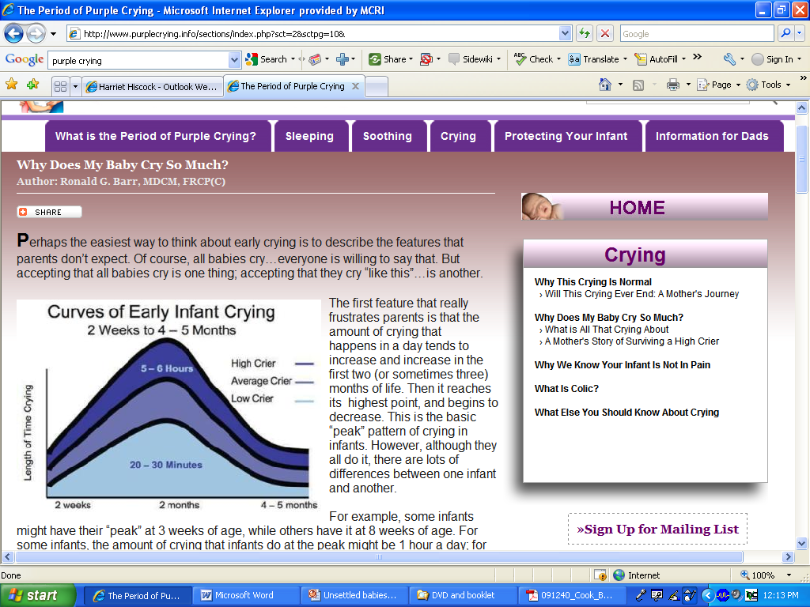

Slide 19
Infant crying
‘Problem’ crying reported by Australian parents
    19% at 2 months
    12.8% at 4 months¹
Can co-exist with feeding and sleeping problems
Associated with adverse outcomes³
    increased risk of PND - 45% of mothers and 30% of fathers attending our Unsettled Babies Clinic²
    early weaning
    multiple formula changes
    anti-reflux and OTC medication
    Shaken Baby Syndrome
        ¹Wake Pediatrics 2007, ² Smart JPCH 2006, ³Douglas MJA 2010

Slide 20
Parenting and crying
Cross cultural but in developing countries:
- crying bouts shorter
- parents less likely to report crying as a problem
Even if baby held > 18 hours/day and fed on demand, still have periods of inconsolable crying¹
      ¹St James-Roberts, Pediatrics 2006
Notes:
Best quality, prospective, community based studies, 5-19% of babies are classified as crying excessively but not all mothers seek help for these babies.
Crying is an expensive problem. The cost to the National Health Service in England has recently been estimated at US$104 million per annum
Crying occurs across cultures. Babies from non-western cultures tend to cry as frequently as western babies but the crying bouts tend to be shorter and parents are less likely to report crying as a problem. We don’t know if this is due to differences in caretaking or genetic predisposition to cry or a combination of both.

Slide 21
Case study - EK
3 month old boy
Crying/irritable “since birth”
Hyper alert and sensitive to his environment
Takes 1-2 hours to get to sleep with rocking, walking etc
Falls asleep at 11pm; wakes 1-3 hourly
Catnaps for 40 mins during the day
Arches back, goes red in the face and ? back swallows
Have tried multiple formulas
On losec - ? effect
Otherwise well, gaining weight, developing normally

Slide 22
Strategies
Discuss normal sleep, sleep cycles
Identify sleep cues – parent in/dependent
Recognise baby’s tired signs
Consistent bedtime routine
Similar bedtime each night
Settling strategies from around 2-3 months
  modified controlled comforting
  camping out
sleep hygiene

Slide 23
The tired baby
Tired signs
  jerky movements
  frowning
  grizzling
  crying
Often misread as boredom, hunger
Rough guide:
  infants aged 5-6 weeks tired after 1 ½ hours
  infants aged 12 weeks tired after 2 hours

Slide 24
Tired signs – older babies

Slide 25
Modified controlled comforting
Aims to teach baby to self-settle
Put baby into cot drowsy but awake
Parent settles baby at 1-2 min intervals if baby crying
Settle by stroking, patting, gentle rocking in cot; one strategy at a time!

Slide 26
Camping out (adult fading)
More gradual
Parents place camp bed/chair next to bed and pat or lie with baby until baby falls asleep
Gradually remove their bed/chair from baby’s room over 2 to 3 weeks

Slide 27
Camping out
Parents must return to the bed/chair when their baby wakes overnight
Parents need to ignore any “games” and keep it boring!

Slide 28
Clinic protocol
Written management plan
Sleep diary
Review in 1-2 weeks

Slide 29
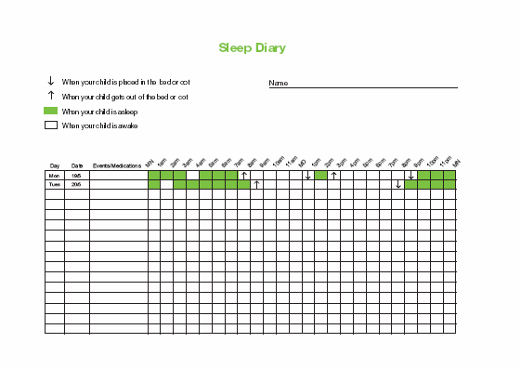

Slide 30
GOR is NOT a common cause of crying
N = 151 infants hospitalized for irritability and 24-hour pH monitoring:
  no association between no. of reflux episodes and crying time
  no association with pathological GOR and back arching
  vomiting > 5 times a day was the most specific reflux symptom
  if no vomiting or feeding difficulties, GOR unlikely (NPV 87-90%)
  Heine et al, J Paed Child Health 2006

Slide 31
GOR medications and crying
  H₂receptor antagonists
    – no effect when compared with placebo
  Proton pump inhibitors
    - no effect when compared with placebo
  van der Pol, R J et al. (2011) Pediatrics 127: 925-935
  Antacids (mylanta, gaviscon)
    no placebo controlled RCTs
Notes:
Crib vibrators have been found to be as effective as infant massage but we don’t know if they are any more effective than doing nothing.
Sucrose calms colicky babies more than water but is less effective in colicky than control babies.
Herbal tea containing chamomile, liquorice, fennel and balm mint has been proven to be effective in one randomised trial. No adverse effects but the babies received 32ml/kg/day of tea and prolonged use might decrease milk intake.
Spinal manipulation has been shown to be as effective as placebo in a well designed randomised controlled trial where parents and the paediatrcian measuring outcomes were blinded to whether the baby had received manipulation.

Slide 32
Management flow chart for crying
History and examination
Vomiting, diarrhoea,
mucousy/bloody BA eczema, FHx FA
failure to thrive
Medical cause unlikely
Baby tired?
Baby hungry?
Baby unable to self-soothe?
Discuss normal sleep and crying
Discuss settling techniques
Maximise parental support
Arrange regular follow up
  No
Yes
Vomiting
Consider
Cow’s milk protein allergy
(GORD – if haematemesis,
FTT)
Diarrhoea
and/or
failure to thrive
Consider
lactose intolerance
Cow’s milk protein allergy
Faecal reducing substances > 0.25% and faecal pH < 7.0
Space feeds > 3 hourly
Trial of lactose free formula or lactase treated breast milk
Trial of cow’s milk free formula or cow’s milk free maternal diet

Slide 33
TB - 8 month old
Takes ~ 1.5 hours to get to sleep
Falls asleep with bottle and then dummy on couch
Transferred to bed, wakes in 5 mins or ~ 2 hours later
Cries until bottle (160mls) and dummy
Wakes every 2 hours thereafter, has bottle 100-160mls
Mother- exhausted, not really enjoying him
Father- shift work

Slide 34
Interventions
Give last feed outside bedroom
Finish feed ~ 20 mins before bedtime
Quiet activities (read book) after feed
Dummy:
  remove OR teach infant to replace it (from 7 months)
Wean off night feeds
  by 20mls every 2 nights or by 2 mins if breast fed

Slide 35
Controlled comforting
Aims to teach baby to self-settle
Baby is put into cot drowsy but awake
Parent returns to baby if baby crying
Return after increasing time intervals eg 2,4,6,8 minutes
Settle either briefly (ie < 1 minute) OR until baby quiet but not asleep

Slide 36
Camping out
Gentler option
Suitable if:
  infant appears anxious (as opposed to angry) when parent leaves
  parent/s cannot cope with infant crying
Other option:
‘parental presence’ ie parent stays in child’s room without touching for 7 nights straight

Slide 37
Extinction burst
Burst of behaviour you have extinguished
Usually 2-3 weeks down the track
Affects around 20% of infants/children
Baby starts waking up again with no obvious cause (ie well)
Must warn parents about it...otherwise they think they are ‘back to square one’

Slide 38
Does controlled comforting cause harm?
Follow up of Infant Sleep Study children at age 1, 2 and 6 years;
half had received controlled comforting at 8 months and half had not
At age 1
  85% of mothers reported a positive intervention effect on
  the mother-child relationship
At age 2 intervention compared with control families had
    fewer persistent sleep problems (11 vs 22%)
    less maternal depression (15 vs 26%)
    no difference in child behaviour or parenting
At age 6 years
  no difference in child sleep, behaviour, parent-child relationship or salivary cortisol (marker of child stress)
  Hiscock 2007; Hiscock 2008; Price 2010; all Pediatrics

Slide 39
Recent article
Middlemiss et al. Earl Hum Dev (2012)
25 infants enrolled in a 5-day inpatient sleep training program using unmodified extinction (crying-it-out).
Salivary cortisol sampled (infants and mothers) on night 1 and 3, at “initiation of the night sleep routine” and “20 min after infants’ onset of sleep”
Conclusions:
“mothers’ and infants’ cortisol responses were positively associated at initiation of nighttime sleep following a day of shared activities…. On the third day of the program, however, results showed that infants’ physiological and behavioural responses were dissociated. They no longer expressed behavioural distress during the sleep transition but their cortisol levels were elevated. Without the infants’ distress cue, mothers’ cortisol levels decreased”

Slide 40
Recent article
Results:
Sleep
“On the first day of the sleep training program, all infants engaged in 2 or more bouts (5-10min) of crying. In contrast, by the third day of the program, all infants settled to sleep independently without a bout of distress signaled through crying.” (p.230)
Cortisol
 | Night 1 | Night 3 | difference
Infants Mothers | .453 ±.769 | .512 ±.900 | + .06 | Negligible difference
 | .580 ±.904 | .412 ±.675 | - .21 | Small decline

Slide 41
Medication
Vallergan/phenergan
only over age of 2 years and only with behaviour management
I use 1mg/kg and taper over 5-7 nights
Melatonin
only helps with getting to sleep
NOT for overnight waking
use in true insomnia
give 30 mins before desired bedtime
1-3mg (preschool); 3-6 mg (teenagers)

Slide 42
Summary
  Ask parent/s about their goals
  Ensure good sleep hygiene
  Offer families a range of strategies; let them choose
  Use a sleep diary
  Review in 1-2 weeks
  Warn about “extinction burst”

Slide 43
Web based resources
www.raisingchildren.net.au (0-18 years)
PURPLE CRYING website
http://www.purplecrying.info/
Online infant sleep training ($50)
www.learninghub.org.au/course/category.php?id=10
  Sleep Health Foundation – tip sheets
  www.sleephealthfoundation.org.au

Slide 44


Slide 45
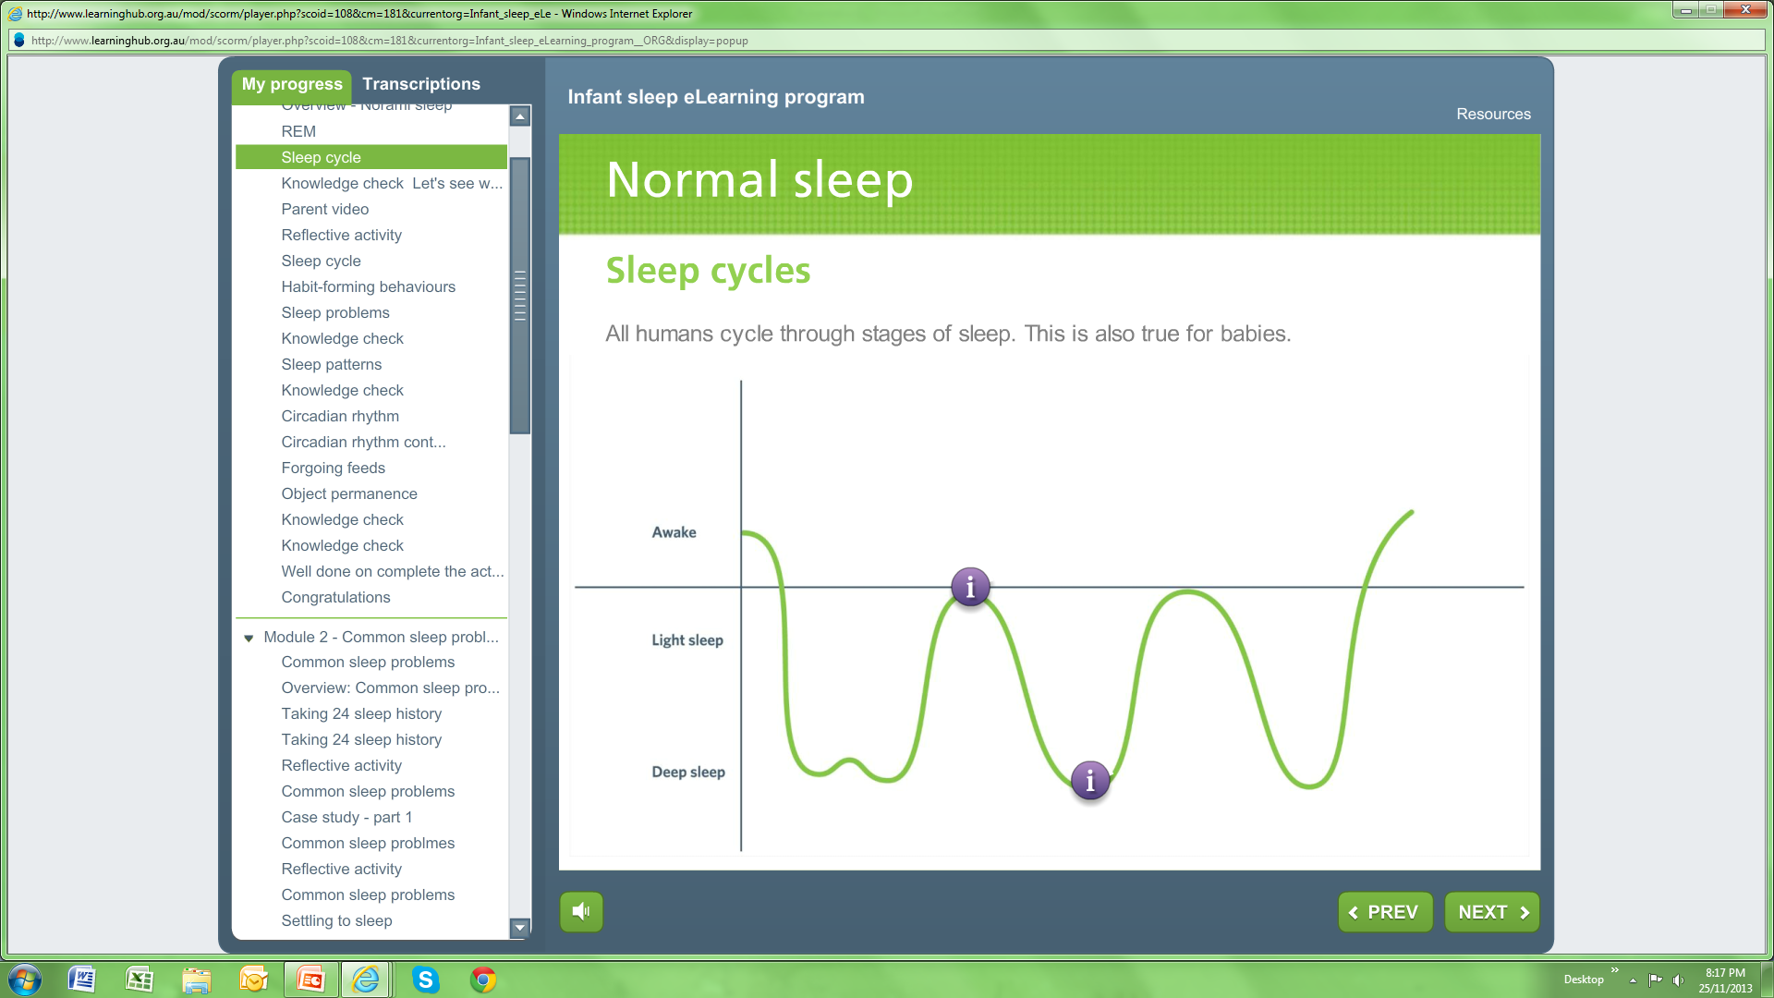

Slide 46
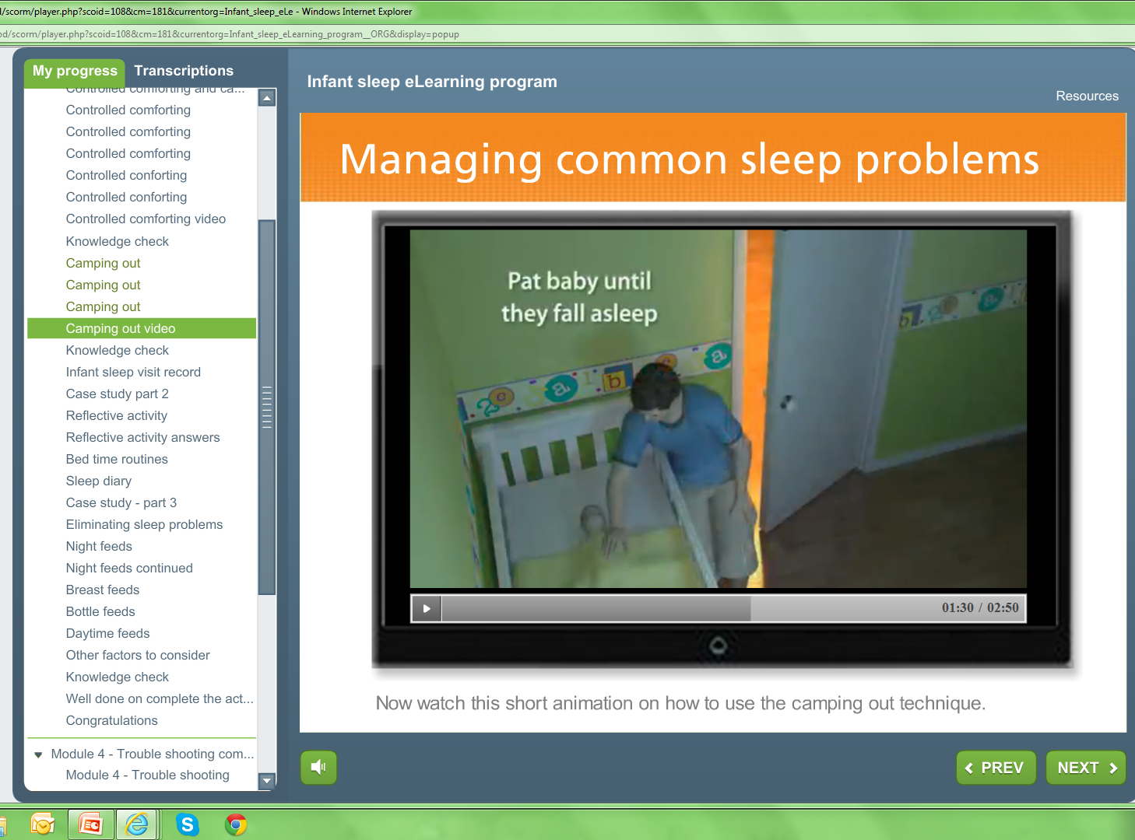

Slide 47
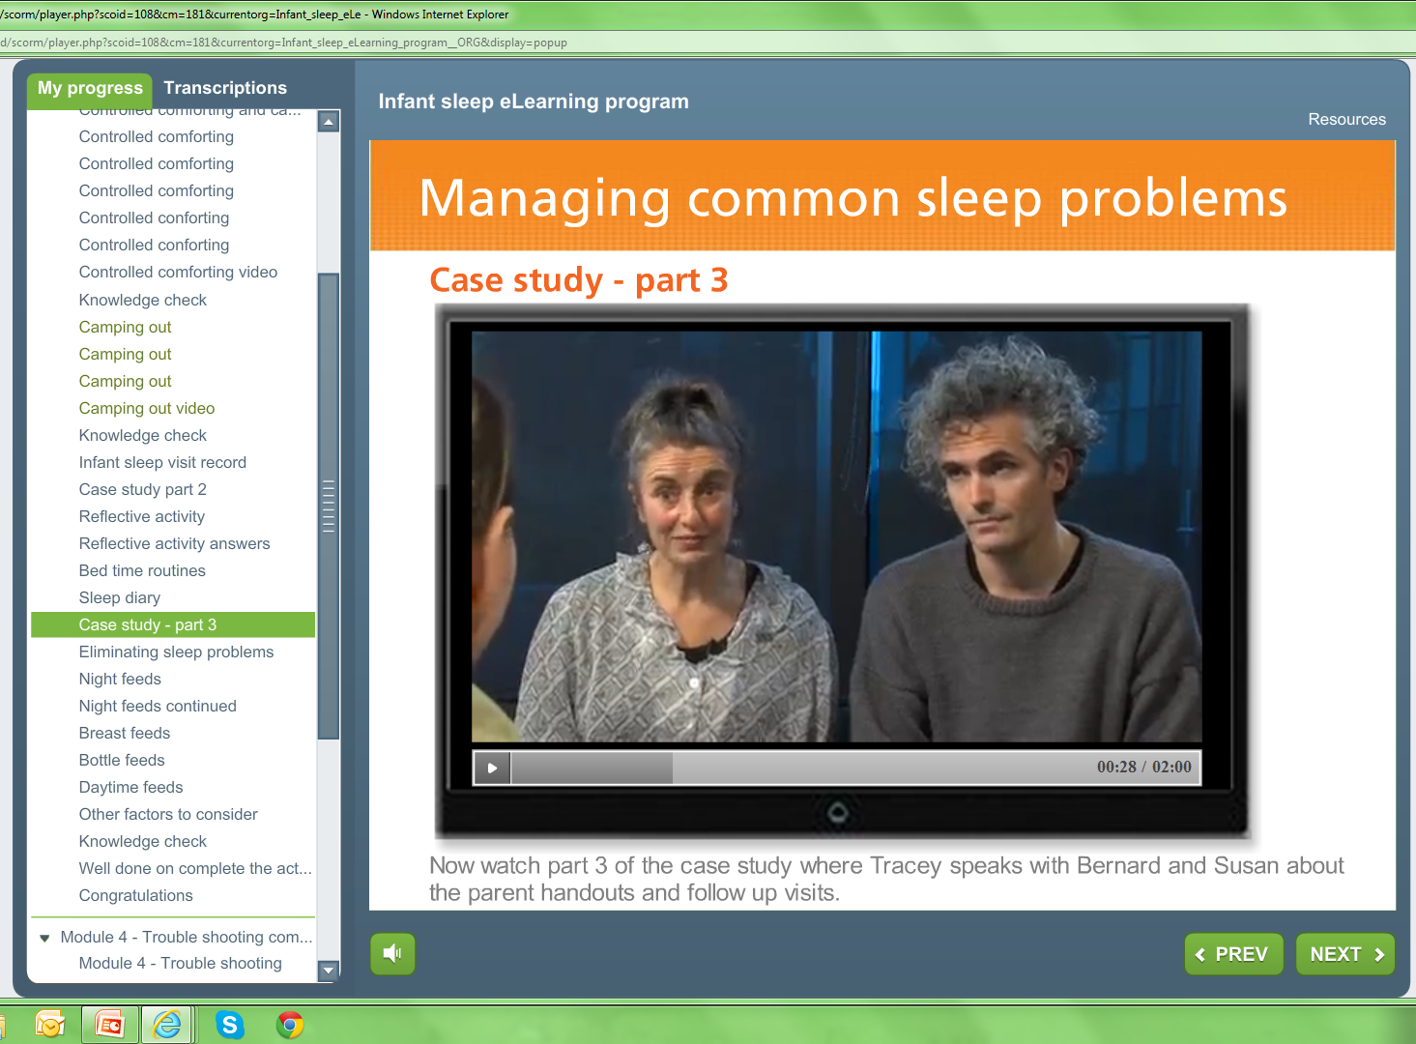

Slide 48
